Slide 1

Hello!

Slide 2
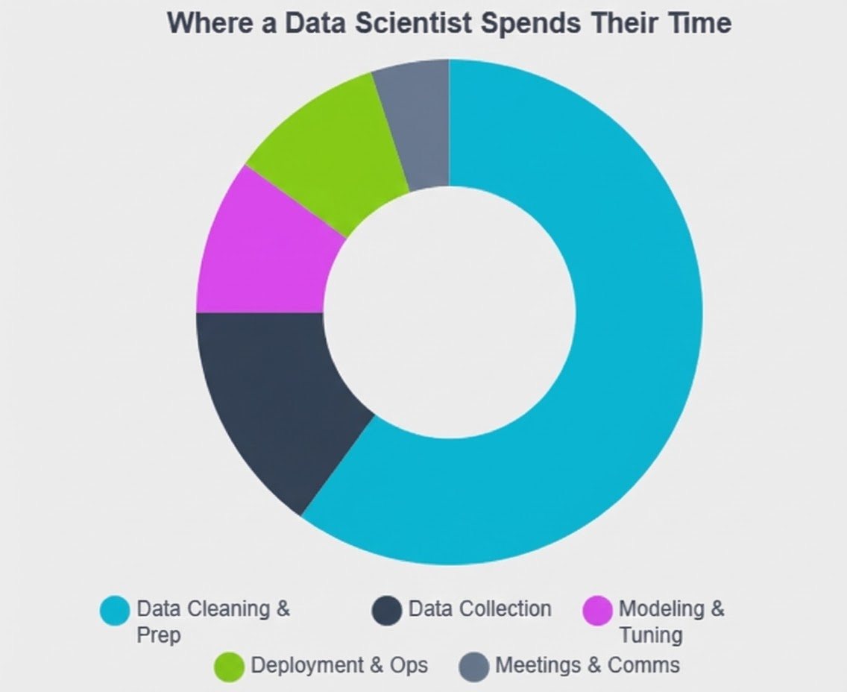
The 80/20 Reality

Slide 3
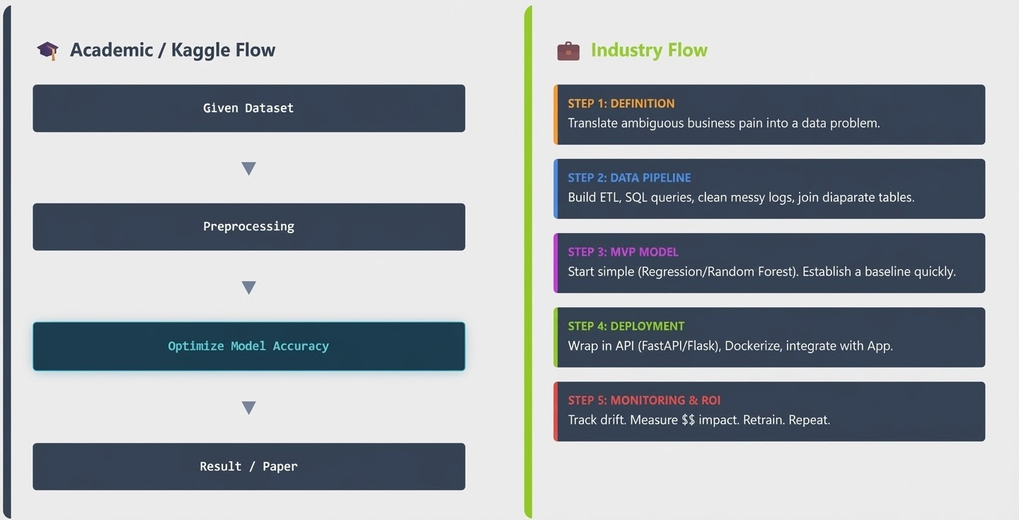

Slide 4
Criteria | Academic Context | Industrial Context
Success Metric | Accuracy, F1-Score, Log-Loss. | ROI, Customer Churn Reduction, Latency (ms), Uptime.
Scalability | Works on a laptop/Colab (small batch). | Scales to millions of requests/day; handles concurrency.
Latency | Irrelevant; batch processing is acceptable. | Critical; real-time inference often required (<100ms).
Maintenance | None; code is archived after publication. | Continuous; CI/CD pipelines, drift detection, on-call rotation.
Code Quality | "Spaghetti code" acceptable if results are correct. | Modular, tested, documented, compliant with linting standards.

Slide 5
Career Options
1] The Foundational Triad: Scientist, Engineer, Analyst
1.1 The Data Scientist: The Scientific Problem Solver
1.2 The Data Engineer: The Infrastructure Architect
1.3 The Data Analyst: The Business Intelligence Strategist
2] The Emerging AI Specialists
2.1 Machine Learning Engineer (MLE): The Productionizer
2.2 Generative AI Engineer: The New Frontier
2.3 AI Ethicist & Responsible AI Officer

Slide 6
1.1 The Data Scientist: The Scientific Problem Solver
The role of the Data Scientist has matured from experimental modeling to delivering measurable business impact. Expected to be a "Full-Stack" professional.
Core Responsibility: The primary mandate is to solve complex business ambiguity using statistical modeling and machine learning.
The Differentiator: Storytelling and explainability have emerged as the critical differentiators.
Skill Requirements: Strong foundation in statistics, proficiency in Python (Scikit-Learn, Pandas), and a deep understanding of ML algorithms (Random Forest, XGBoost, Gradient Boosting).

Slide 7
1.2 The Data Engineer: The Infrastructure Architect
Often described as the "unsung heroes" of the AI revolution. The logic is simple: advanced AI cannot exist without robust data infrastructure.
Core Responsibility: Building and maintaining scalable data pipelines (ETL/ELT), managing data lakes and warehouses (Snowflake, Databricks, BigQuery), and ensuring data quality and governance.
The Differentiator: Engineers who can seamlessly integrate unstructured data (text, images) into analytical pipelines are indispensable.
Skill Requirements: Apache Spark, Apache Kafka for streaming, Airflow for orchestration, and proficiency in SQL and Python/Scala.

Slide 8
1.3 The Data Analyst: The Business Intelligence Strategist
The role of the Data Analyst has evolved from "report generation" to "strategic insight generation."
Core Responsibility: Translating raw data into actionable business intelligence. This involves cleaning data, creating interactive dashboards, and conducting ad-hoc analyses to answer immediate business questions.
The Differentiator: Business acumen is the primary asset. An analyst who understands unit economics, marketing funnels, or supply chain dynamics can generate insights that a purely technical coder cannot.
Skill Requirements: Advanced SQL, PowerBI/Tableau, and increasingly, Python for statistical analysis.

Slide 9
2.1 Machine Learning Engineer (MLE): The Productionizer
The Machine Learning Engineer bridges the gap between the Data Scientist's prototype and the software engineer's production system.
Core Responsibility: Taking a model that works on a laptop and making it work at “scale”. This involves optimizing model performance, managing infrastructure, and implementing monitoring systems.
The Differentiator: Mastery of MLOps (Machine Learning Operations). The ability to build CI/CD pipelines for ML, manage data and model versioning (using MLflow and DVC), and implement A/B testing frameworks in production is non-negotiable.
Skill Requirements: TensorFlow/PyTorch, Docker, Kubernetes, Cloud Platforms (AWS SageMaker/Azure ML).

Slide 10
2.2 Generative AI Engineer: The New Frontier
As companies move from "chatbots" to "cognitive engines," the need for specialized GenAI talent has exploded.
Core Responsibility: designing and deploying systems powered by Large Language Models (LLMs). This includes fine-tuning models, building RAG pipelines to ground models in enterprise data, and optimizing context windows.
The Differentiator: Deep understanding of the "AI Stack" for GenAI—LangChain for orchestration, vector stores for memory, and evaluation frameworks (like RAGAS) to prevent hallucinations.
Skill Requirements: Python, LangChain, Hugging Face ecosystem, OpenAI/Anthropic APIs, Prompt Engineering.

Slide 11
2.3 AI Ethicist & Responsible AI Officer
With the implementation of regulations like India's Digital Personal Data Protection (DPDP) Act, companies face legal and reputational risks from biased or unsafe AI.
Core Responsibility: Auditing AI systems for bias, fairness, and safety. They develop governance frameworks to ensure models do not discriminate or hallucinate harmful content.
The Differentiator: A hybrid background combining technical understanding of model interpretability (SHAP/LIME values) with knowledge of legal and sociological frameworks.

Slide 12
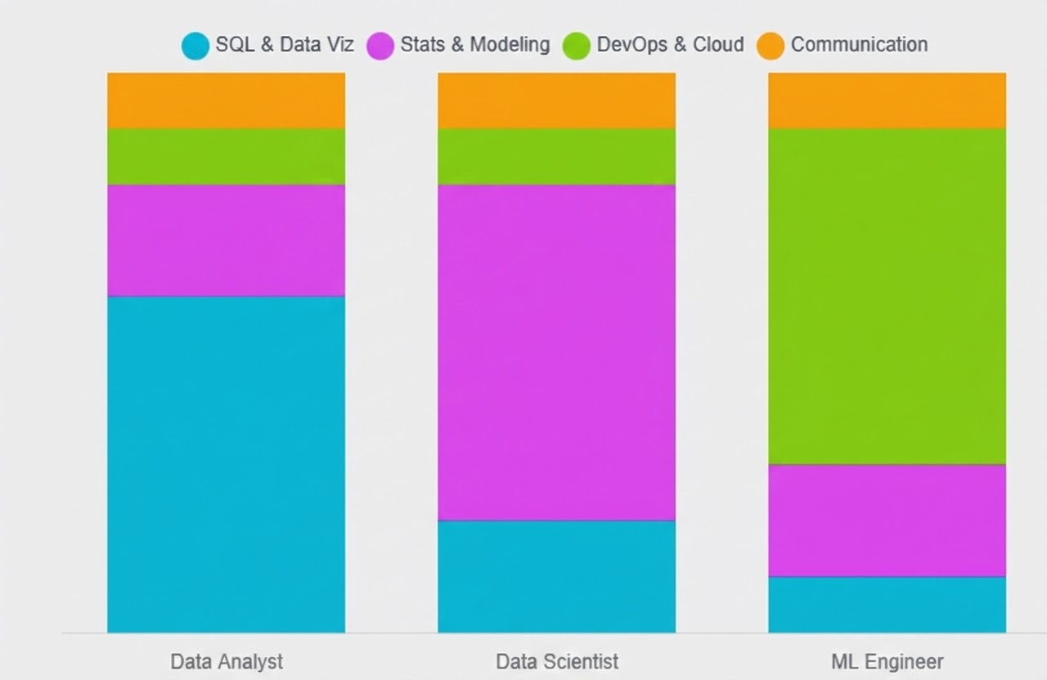
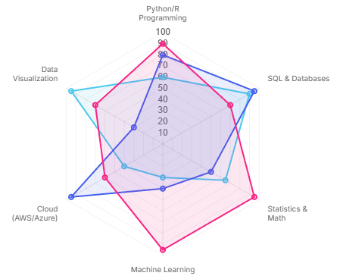
Skills

Slide 13

Why is analysis important?

Slide 14



Understanding Customer Habits

Slide 15
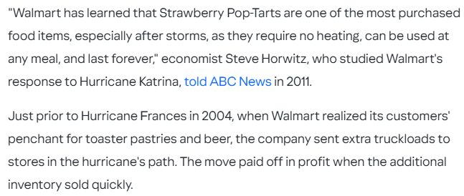
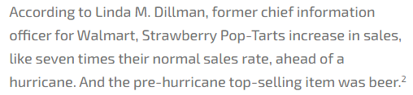
Understanding Customer Habits

Slide 16
GenAI Real-World Engineering Case Studies
1] DoorDash: High-Velocity Contact Center Automation
DoorDash faced a massive challenge: handling hundreds of thousands of daily support calls from Dashers (drivers), consumers, and merchants. They turned to Generative AI not just to "chat," but to resolve issues.
The Latency Challenge: Drivers on the road are time-sensitive. A latency of 5-10 seconds for an LLM response is unacceptable. DoorDash utilized Amazon Bedrock and Anthropic’s Claude 3 Haiku—a smaller, faster model—to achieve response times under 2.5 seconds.
The Testing Moat: They didn't just deploy the model. They built a massive automated testing framework using Amazon SageMaker. This framework scaled their testing capacity by 50x, allowing them to run thousands of simulated conversations against "ground truth" data to ensure the model wasn't hallucinating policies before it ever spoke to a human.

Slide 17
GenAI Real-World Engineering Case Studies
2] Uber: From Predictive to Agentic
Uber has long been a pioneer in predictive AI (ETA, pricing). In 2025, they are pivoting to Agentic AI.
GenAI Gateway: Uber built a centralized gateway to manage LLM interactions, handling authentication, rate limiting, and cost attribution across the enterprise. This "middleware" layer is crucial for governance.
Agentic Workflows: Uber is moving beyond simple chatbots to systems that can plan and execute. Their vision for 2026 involves agents that can autonomously handle complex customer service resolutions, utilizing a "ReAct" (Reason + Act) loop to query internal databases, verify policy, and issue refunds without human intervention.

Slide 18
GenAI Real-World Engineering Case Studies
3] Airbnb: Technical Debt Reduction
Airbnb utilized GenAI to solve a massive software engineering headache: migrating thousands of test files from an outdated framework (Enzyme) to a modern one (React Testing Library).
The Methodology: They didn't rely on simple prompts. They built an agentic workflow. The AI would generate the new test code, run it, capture any error messages, and retry the generation with the error context.
The Result: This iterative feedback loop allowed them to migrate 3,500 files in just 6 weeks—a task that would have taken months of manual developer time.

Slide 19
Building the Perfect Portfolio: End-to-End Projects
Production-Grade Churn Prediction
Objective: Demonstrate MLOps, Business Value, and Cloud Engineering.Do not just call model.fit(). Build a pipeline.
Stage | Component | Industry Standard Implementation
Ingestion | Airflow | Scheduled DAGs to pull data from a Data Warehouse
Featurization | Feature Store | Use Feature Store to serve consistent features for training and inference.
Modeling | XGBoost | The gold standard for tabular data. Use Optuna for hyperparameter tuning.
Tracking | MLflow | Log every experiment, parameter, and metric. This creates auditability.
Serving | FastAPI + Docker | Wrap the model in a REST API, containerize it.
Monitoring | Evidently AI | Crucial: Monitor for Data Drift. If the input data changes, trigger a retraining pipeline.
Business Value | Dashboard | Create a dashboard showing not just "Accuracy," but "Projected Revenue Saved".

Slide 20
Building the Perfect Portfolio: End-to-End Projects
Enterprise RAG System
Objective: Demonstrate GenAI Engineering and Retrieval Systems.
Building a chatbot that talks to a PDF is a toy project. Building a secure Knowledge Base is a resume-maker.
Ingestion Pipeline: Build ETL scripts to scrape documentation
Chunking Strategy: Use advanced strategies (e.g. "Semantic Chunking" or "Parent-Child Chunking") to preserve context, rather than simple character splitting.
Vector Database: Implement vector database with Metadata Filtering. (e.g., "Only search documents from the 'Engineering' department").
Retrieval Logic: Implement Hybrid Search (Keyword + Vector) and Re-ranking to maximize relevance.
Evaluation: Implement "LLM-as-a-Judge" (using frameworks like RAGAS) to automatically score the quality of answers to improve reliability.

Slide 21
Building the Perfect Portfolio: End-to-End Projects
The "Platform" Project
Objective: Demonstrate Infrastructure and DevOps skills.
Focus purely on the plumbing. Build a CI/CD pipeline for ML.
Trigger: A git commit to the main branch.
Action: GitHub Actions triggers a training job.
Gating: The pipeline compares the new model's performance against the current production model.
Deployment: If the new model is better, it is automatically deployed to a shadow endpoint.
This demonstrates a deep understanding of the software development lifecycle (SDLC) applied to ML.

Slide 22
Thank You!

